Slide 1
Why sparq for homeowner?

Slide 2



Key questions from Homeowner
What are the Limitations of Existing Leading Brands?
What Features Should Homeowners Demand and Watch For?
Why Specifically Ask for Sparq Products?

Slide 3

What are the Limitations of Existing Leading Brands?

Slide 4

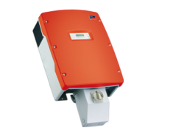
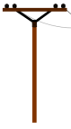

Traditional String Inverters
Traditional String Inverter: Many Panels In Series and One Central DC-AC Inverter
Reliability
Design life of 10 years → requires replacement
AC
Single point of failure
600+V DC
Productivity
Module mismatch, shading, soiling, “Christmas light” effect
Design & installation
Requires specialized design and installation
Requires expensive Balance of System
Safety
Multiple series Panels + ➔
One HV Central Inverter
Cheap, But…
High voltage (600V+) arc faults → leading cause of fires of PV installations
Always live; no module level disconnect/shut-off
Notes:
In string inverters multiple panels are traditionally used in series to generate a high DC voltage. This is cheap, but there are multiple problems as highlighted. Reliability is less than 10 years, There are multiple single points of failure. Particularly if there is shading, energy harvesting is limited to the lowest energy panel! High cost of installation and maintenance. And most importantly, major safety concerns around HV DC arcing, electric shock and fire incidents causing numerous fatalities and significant property damage.

Slide 5
Many Optimizers + String Inverter
SolarEdge: One Optimizer/Panel + Many Panels In Series + HV DC-AC Inverter
Reliability
Design life of 12 years → requires costly replacement
AC
600+V DC
Single point of failure
Productivity
5-20% more energy as a result of individual Maximum Power Point Tracking (MPPT)
+
Design & installation
String sizing required – difficult to design, install, maintain and repair
Safety
High voltage (600V+) arc faults → leading cause of fires in PV installations, electirck shock hazard
One Optimizer + HV Central
Per Panel Inverter
Medium Cost
Safety Risk
+
Module level disconnect/shut-off
Notes:
Adding optimizers for each panel provided individual Maximum Power Point Tracking (MPPT) for each panel, and helped remove the shading problem but despite increasing the cost of system significantly major concerns including HV arcing, electric shock hazard, safety concerns and short life-time of system could not be resolved!

Slide 6
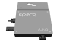
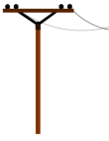
Single-Channel Microinverters
Enphase: One Single-Channel Microinverter with MPPT per Panel
Reliability
+
No single point of failure
Design life of 12 years (Electrolytic Capacitor)
AC
Productivity
5-20% more energy as a result of individual Maximum Power Point Tracking (MPPT)
+
Design & installation
+
No risky high voltage DC simplifies design and installation
High overall life-cycle cost (manufacture, install and repair after 12 years
Cost
High
Safety
One Microinverter per Panel ➔
+
“All Alternating Current (AC)” solution at low voltage eliminates arc faults
Notes:
Disturbed lower power inverters, called microinverters - one for each panel, were introduced to eliminate the HV DC and risk of HV DC arcing and electric shock. However, the cost of the system significantly increased. Also, due to use of electrolytic caps, the microinverters also suffer low reliability and short life of less than 12 years, as explained in next slide.

Slide 7
Limitations of Leading Brand PV systems
SolarEdge String Inverters Enphase Single-Channel Microinverters
Safety risk due to high voltage DC and arcing
Conventional power electronics and time-averaged liner control method
Require large electrolytic capacitors
No galvanic isolation
Low MTBF, poor system availability and reliability
Multiple Single point failures in the system
Low energy harvesting without optimizers
Optimizers, an after thought for shading and MPPT
Require excessive power quality and EMI fi
Excessive volume, weight and cost penalty
Low energy harvesting due to power clipping at high ambient temperatures
Inefficient supply chain, tedious to install & repair
Conventional Flyback boost Converters
Conventional power electronics and time-averaged liner control method
Mainly H/W based with simplified control methods using averaged models
Require huge electrolytic capacitors
Low MTBF and poor reliability
Require excessive power quality and EMI due to high Total Harmonic Distortion
Excessive volume, weight and cost penalty
Low energy harvesting due to power clipping at high end of the normal operational ambient temperatures
Inefficient supply chain, tedious to install & repair
Competing microinverters suffer from poor performance and reliability due to use of conventional H/W based technologies with linear control techniques.

Slide 8
What homeowners should demand and watch for?

Slide 9
What homeowners should demand and watch for?
Ask for Your Options and Side-by-Side Comparison of Features!
Performance
High Frequency, soft-switching power electronics
Advanced real-time control
Individual MPPT for each panel
No HV DC cabling on the roof
Lowest weight of microinverters on the roof
Maximum Energy Harvesting
Dual Mode Operation (On-grid & Off-grid);
Grid-Resilience,
Grid independence
energy self-sufficiency
Future ready for being flexible and scalable
Robust IOT gateway for health monitoring & control
Web monitoring with Intuitive displays
User-Friendly mobile app
Accessible and expert technical support
Safety & Reliability
No Electrolytic Capacitor
No other low-life components Safe,
All-AC cabling with inherent Rapid-Shut-Down (RSD) compliance
No risk of HV DC arcing
No Risk of HV electric shock hazard for first responders
High reliability
High system availability
No PV system single point failure
Minimize number of system components to install and maintain results for high MTBF
Longlisting
Comprehensive warranty
Cost-Effectiveness
Quad Architecture
Reduced manufacturing BOM
Reduced Balance of System (cabling, grounding, junction boxes etc)
Reduced manufacturing cost
Reduced installation cost
Maintenance-free
Lowest cycle-life-cost
Outlier on Performance-Cost Curve
Do Your Homework. Ensure You Sign-up A Certified Installer. Buy Best-in-Class Products.

Slide 10
Why Specifically Ask for
Sparq Products?

Slide 11
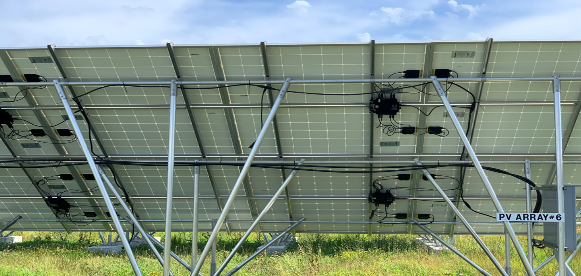
sparq quad architecture advantage!
1 Microinverter per 4 Panels
Safe. Reliable. Long lasting
All AC Cabling. Inherent RSD
Lowest weight, volume &cost
Less Parts to Carry & Install.
Less Time on the Roof.
Easy to Install
Maintenance-free
No More Truck Rolls!
Higher Profit Margin
User-Friendly App
Expert 24/7 Support

Slide 12
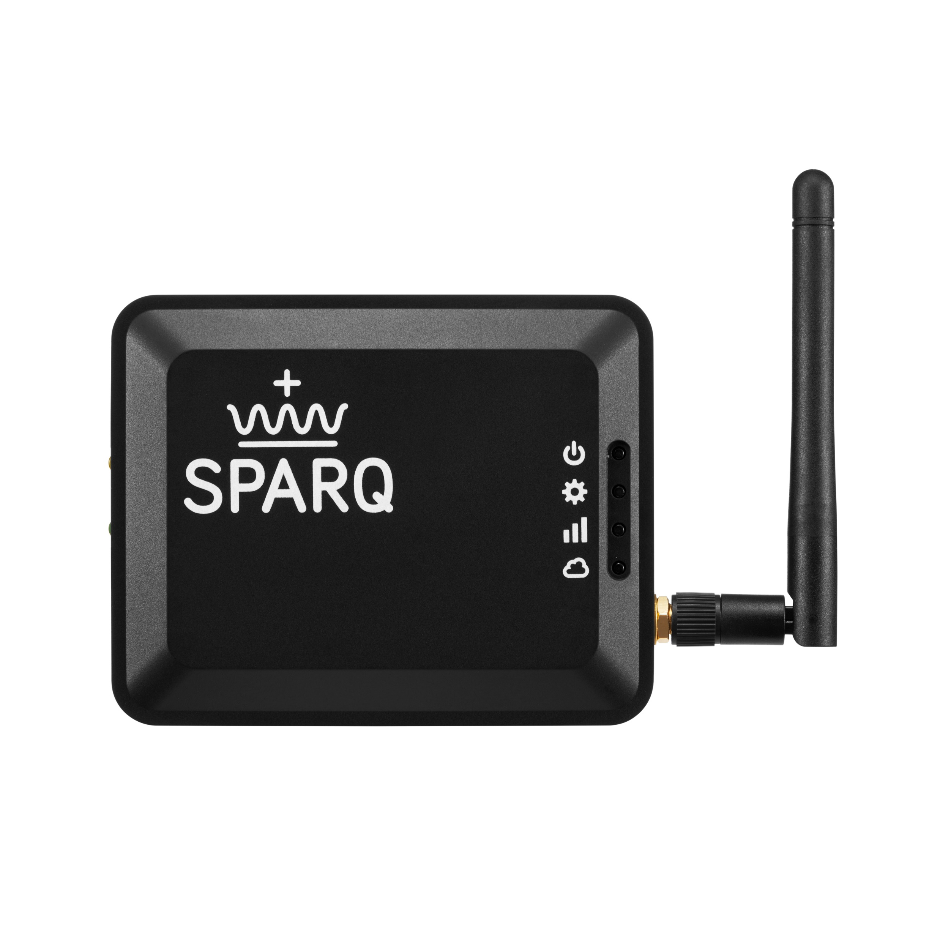
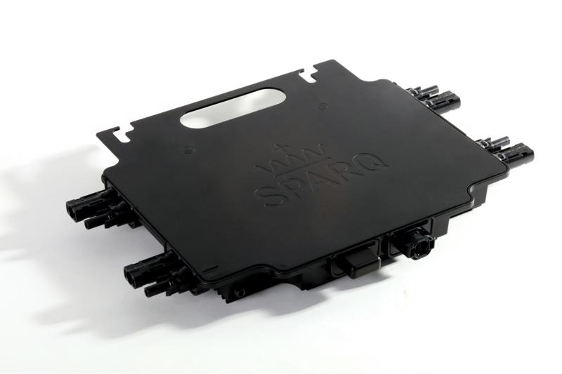
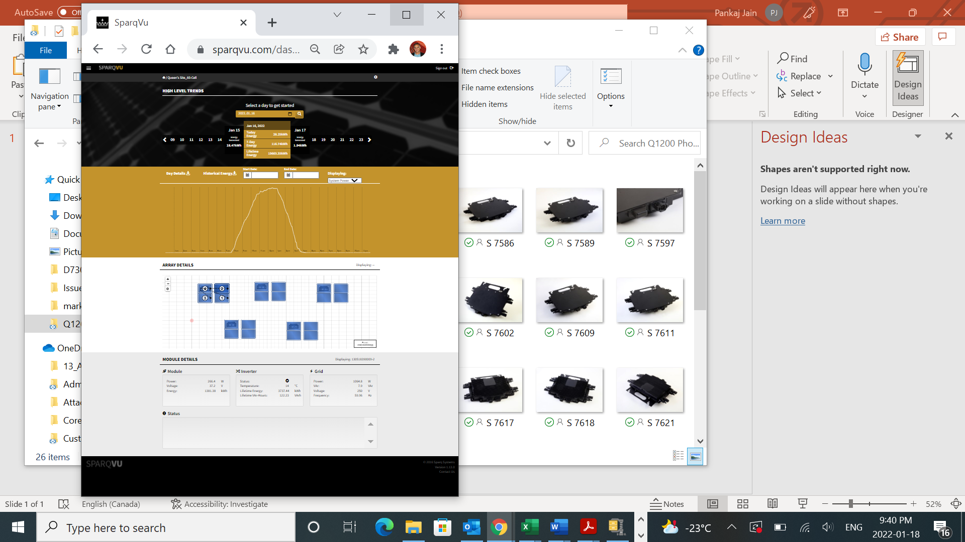
Standard q2000 product family offering
Best-in-Class Single and Three Phase Microinverters, Battery Storage and Energy Management
Q2000
1-Phase
Dual mode
SparqLinq
Gateway
Q2000
3-Phase
Solar water Pump
AC Cabling
SparqVu
Web Monitoring
SparqSync
Mobile App
Q2000
Energy Storage

Slide 13
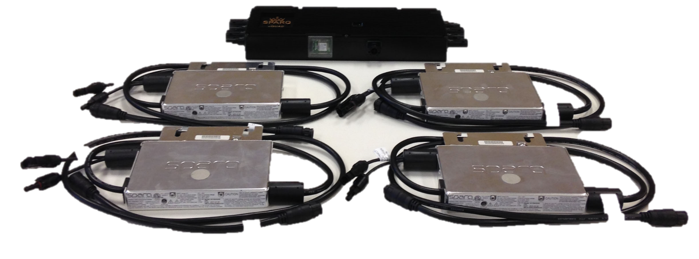
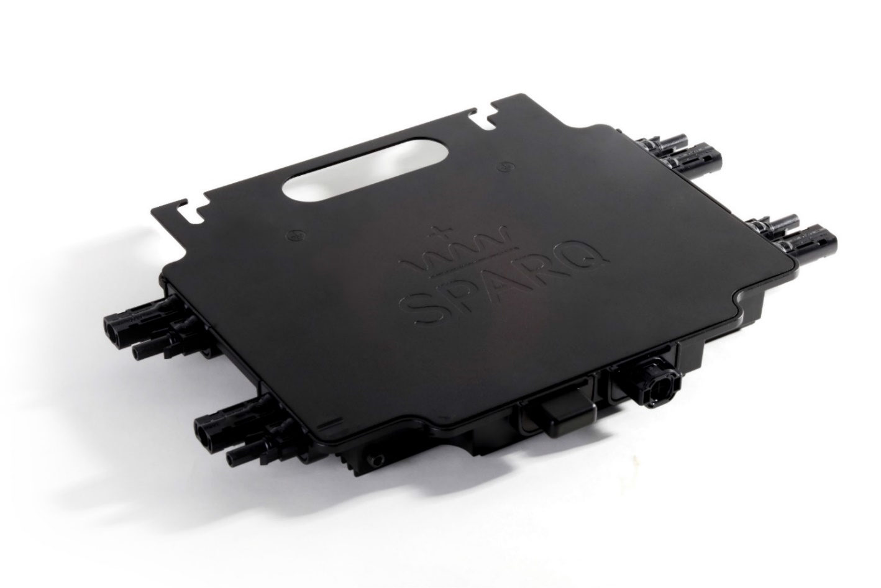
Sparq QUAD Microinverters
Best-Selling Microinverter
Sparq Quad Microinverter
SPARQ’s Quad Architecture Integrates FOUR Microinverters in ONE Enclosure.

Slide 14
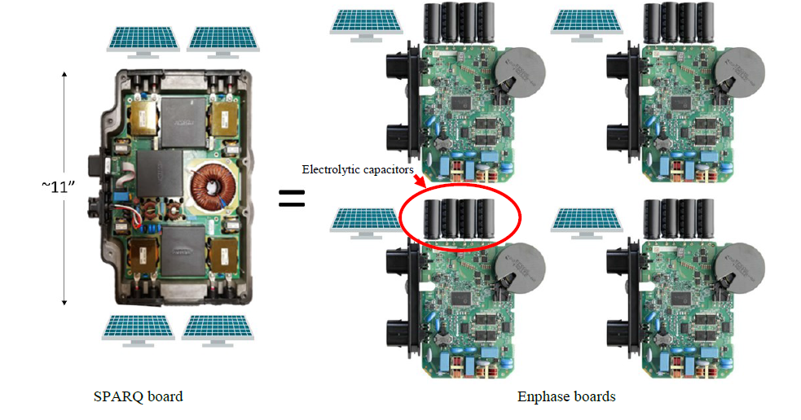
Sparq microinverter vs. leading brand
Improving Reliability and Reducing Cost of Supply-Chain, Manufacturing and Installation
SPARQ Microinverters Eliminates Electrolytic-Caps and All Other Low-Reliability Parts

Slide 15
Sparq products value proposition
Best-in-Class Microinverters Disrupting the PV Industry!
Performance
Software centric flexible Power Electronics with accurate real-time nonlinear control
Ultra high frequency, soft switching topology
Individual MPPT for each panel
No risk of HV DC arcing or personnel electric shock
Lowest weight, highest weight density (W/kg)
Lowest volume, highest power density (W/ in³)
Maximum Energy Harvesting
Dual Mode Operation (On-grid & Off-grid)
Grid-Resilience without energy storage
Grid independence and energy self-sufficiency
Future ready for being flexible and scalable
SparqLinq: advanced gateway to rule them all
SparqVu: Web monitoring with Intuitive displays
SparqSync: user-Friendly mobile app
Safety & Reliability
No Electrolytic Capacitor
Other low-life components eliminated
Safe, all-AC cabling with inherent Rapid-Shut-Down (RSD) compliance
No risk of HV DC arcing
No Risk of HV electric shock hazard for 1st responders
High reliability
High system availability
No PV system single point failure
Fewer system components to install and maintain results in high MTBF
Best-in-class Longevity
Cost-Effectiveness
Quad Architecture
Reduced manufacturing BOM
Reduced Balance of System (cabling, grounding, junction boxes etc)
Reduced manufacturing cost
Reduced installation cost
Maintenance-free
Lowest cycle-life-cost
Outlier on Performance-Cost Curve
Highest Performance, Safe and Most Reliable, Lowest weight, Volume and Cost.

Slide 16


Thank you!

Slide 17
CAUTIONARY STATEMENT
The information contained in this corporate presentation has been prepared by SPARQ Corp. (the “Company”) and contains confidential information pertaining to the business and operations of the Company. The information contained in this presentation: (a) is provided as at the date hereof, is subject to change without notice, and is based on publicly available information, internally developed data as well as third party information from other sources; and (b) is for information purposes only and shall not constitute an offer to buy, sell, issue or subscribe for, or the solicitation of an offer to buy, sell or issue, or subscribe for any securities in any jurisdiction in which such offer, solicitation or sale would be unlawful. Where any opinion or belief is expressed in this presentation, it is based on certain assumptions and limitations and is an expression of present opinion or belief only. Any third party information has not been independently verified. While the Company may not have verified the third party information, it believes that it obtained the information from reliable sources and has no reason to believe it is not accurate in all material respects. No warranties or representations can be made as to the origin, validity, accuracy, completeness, currency or reliability of the information. The Company disclaims and excludes all liability (to the extent permitted by law), for losses, claims, damages, demands, costs and expenses of whatever nature arising in any way out of or in connection with the information in this presentation, its accuracy, completeness or by reason of reliance by any person on any of it. This presentation should not be construed as legal, financial or tax advice to any individual, as each individual’s circumstances are different. Readers should consult with their own professional advisors regarding their particular circumstances.
Certain information set forth in this presentation, together with any supplements and any other information that may be furnished to prospective investors by the Company in connection therewith, contains “forward-looking statements” and “forward-looking information” within the meaning of applicable Canadian securities legislation (referred to herein as forward-looking statements). Except for statements of historical fact, certain information contained herein constitutes forward-looking statements which include but are not limited to statements related to activities, events or developments that the Company expects or anticipates will or may occur in the future, statements related to the Company’s business strategy objectives and goals, and management’s assessment of future plans and operations which are based on current internal expectations, estimates, projections, assumptions and beliefs, which may prove to be incorrect. Forward-looking statements can often be identified by the use of words such as “may”, “will”, “could”, “would”, “anticipate”, ‘believe”, expect”, “intend”, “potential”, “estimate”, “budget”, “scheduled”, “plans”, “planned”, “forecasts”, “goals” and similar expressions or the negatives thereof. Forward-looking statements are neither historical facts nor assurances of future performance. Forward-looking statements are based on a number of factors and assumptions made by management and considered reasonable at the time such information is provided, and forward-looking statements involve known and unknown risks, uncertainties and other factors that may cause the actual results, performance or achievements to be materially different from those expressed or implied by the forward-looking statements.
Risk Factors that could cause actual results, performance or achievement to differ materially from those indicated in the forward-looking statements including those listed in this presentation under the heading “Risk Factors”. Readers are cautioned that the foregoing list and the risk factors under the heading “Risk Factors” are not exhaustive. All of the forward-looking statements made in this presentation are qualified by these cautionary statements and other cautionary statements or other factors contained herein. Although management believes that the expectations conveyed by forward-looking statements herein are reasonable based on information available on the date such forward-looking statements are made, there can be no assurance that forward-looking statements will prove to be accurate, as actual results and future events could differ materially from those anticipated in such statements. The Company undertakes no obligation to update forward-looking statements if circumstances or management’s estimates or opinions should change except as required by applicable securities laws. The forward-looking statements contained herein are presented for the purposes of assisting readers in understanding the Company's plan, objectives and goals and may not be appropriate for other purposes. The reader is cautioned not to place undue reliance on forward-looking statements.
CAUTIONARY NOTE REGARDING FUTURE-ORIENTED FINANCIAL INFORMATION
To the extent any forward-looking statement in this presentation constitutes “future-oriented financial information” or “financial outlooks” within the meaning of applicable Canadian securities laws, such information is being provided to demonstrate the anticipated market penetration and the reader is cautioned that this information may not be appropriate for any other purpose and the reader should not place undue reliance on such future-oriented financial information and financial outlooks. Future-oriented financial information and financial outlooks, as with forward-looking statements generally, are, without limitation, based on the assumptions and subject to the risks set out above under the heading “Forward Looking Information”. The Company’s actual financial position and results of operations may differ materially from management’s current expectations and, as a result, the Company’s revenue and expenses.
INDUSTRY INFORMATION
This presentation also contains or references certain market, industry and peer group data which is based upon information from independent industry publications, market research, analyst reports and surveys and other publicly available sources. Although the Company believes these sources to be generally reliable, such information is subject to interpretation and cannot be verified with complete certainty due to limits on the availability and reliability of data, the voluntary nature of the data gathering process and other inherent limitations and uncertainties. The Company has not independently verified any of the data from third party sources referred to in this presentation and accordingly, the accuracy and completeness of such data is not guaranteed.
© 2025 SPARQ Systems Inc.
For Terms of Service Refer to Sparq Systems Inc. Website.
Forward looking statements are subject to various risks and assumptions. Please see ‘Cautionary Statements’ and ‘Risk Factors’ at the end of this presentation. .

